Slide 1
Crime and Real estate in Metro Atlanta
Rachel Poulos, Danielle Weeks, Eric Roberts

Slide 2
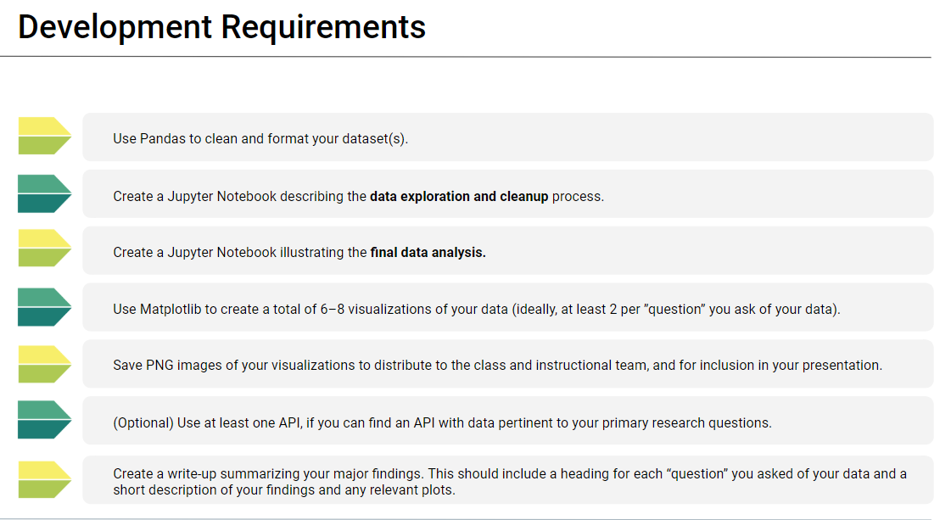
Background

Slide 3
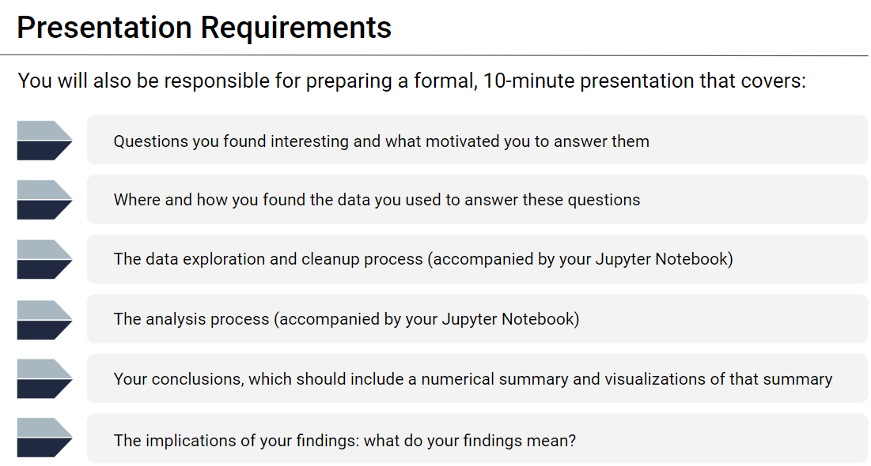
Background

Slide 4
Project purpose
Is there a correlation between crime and real estate values in Metro Atlanta?
For instance, is more crime committed in “poorer” neighborhoods, or do higher priced neighborhoods serve as a “magnet” for crime?
Background
Atlanta divides itself into more than 230 different logical “neighborhoods”.
We analyzed several databases to find answers:
Crime Statistics by Neighborhood, reported by Atlanta Police Department. This database contains every crime reported to APD for several years.
Real Estate Values by a real estate website, Niche.com. We started with Zillow but there it was not suitable to the task. Niche.com has no API; it was necessary to use Web Scraping to get the price data for a given neighborhood.
US Census Data showing population for given neighborhoods.
Combining three separate databases provides insights into geographical crime, crime per capita, crime per real estate value

Slide 5
Results

